Slide 1

Take Home Project for Data Analysis
Using Jupyter Notebook and Python libraries like – Pandas, NumPy and Matplotlib
Performed by
K. Polishchuk

Slide 2
1. Short Project Overview
For this project, you will interpret data from the National Parks Service about endangered species in different parks.
You will perform some data analysis on the conservation statuses of these species and investigate if there are any patterns or themes to the types of species that become endangered. During this project, you will analyze, clean up, and plot data as well as pose questions and seek to answer them in a meaningful way.
After you perform your analysis, you will share your findings about the National Park Service.
Project Objectives:
Complete a project to add to your portfolio
Use Jupyter Notebook to communicate findings
Run an analysis on a set of data
Become familiar with data analysis workflow
Prerequisites:
Data Visualization
Communicating Data Science Findings

Slide 3
2. Available Data.
The species_info.csv contains information on the different species in the USA National Parks. The columns in the data set include:
category - The class of animal
scientific_name - The scientific name of each species
common_names - The common names of each species
Conservation_status - Each species’ current conservation status
The observations.csv contains information about number of time each species are observed in the certain National Park. The columns in the data set include:
scientific_name - The scientific name of each species
park_name - Park where species were found
observations - The number of times each species was observed at park

Slide 4
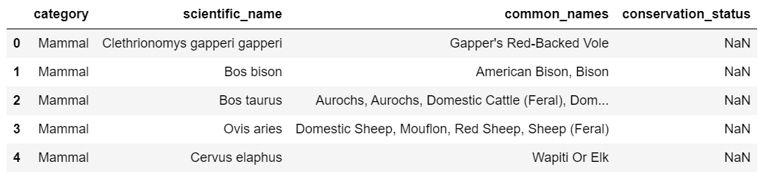

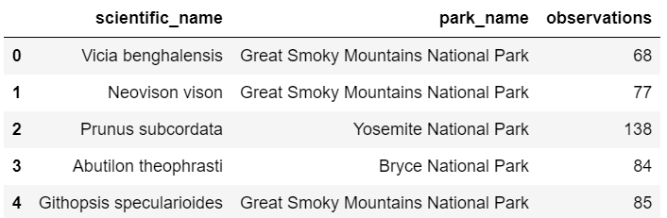
3. Summary of available information.
At first before starting any analysis we need to review the data base. Understand which tables, columns we have, and how those information related to each other. Calculate sum of species names and categories.

Slide 5
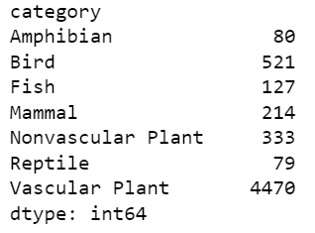
And one of the main questions of this project it is endangered species, how many, which species in which parks.

Slide 6
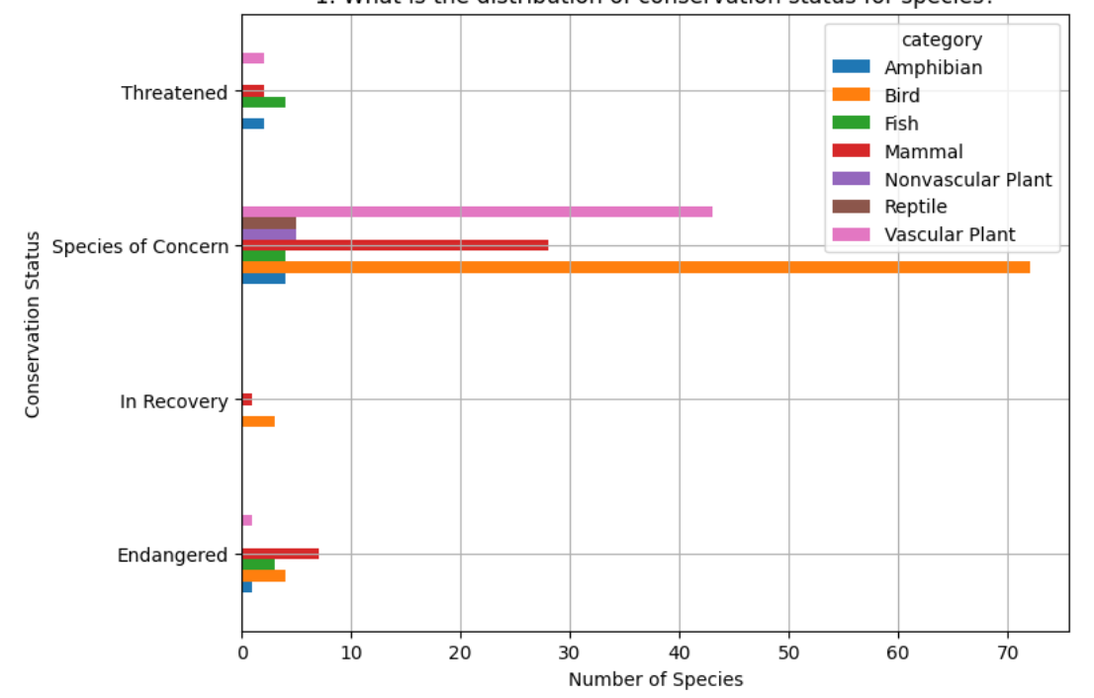
4. Graphs for the visual analysis.
What is the distribution of conservation status for species?
Looking at this graph we can say which species is more endangered and approximate count.
Those numbers are summarized from all the parks depending on their conservation status.

Slide 7
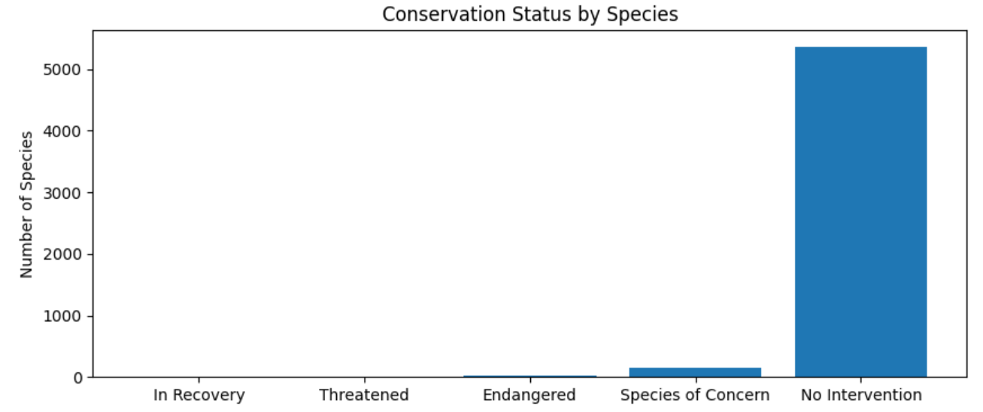
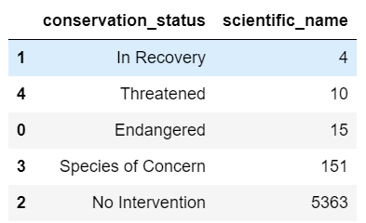
Are certain types of species more likely to be endangered?
For this question first we need to count how many unique species in each conservation status.
Those species, which doesn't have Conservation Status “No Intervention” - are not protected and might have higher chance to be endangered.

